Slide 1
Erasmus +
Sustainability by biotechnology
Miskolc 2017

Slide 2
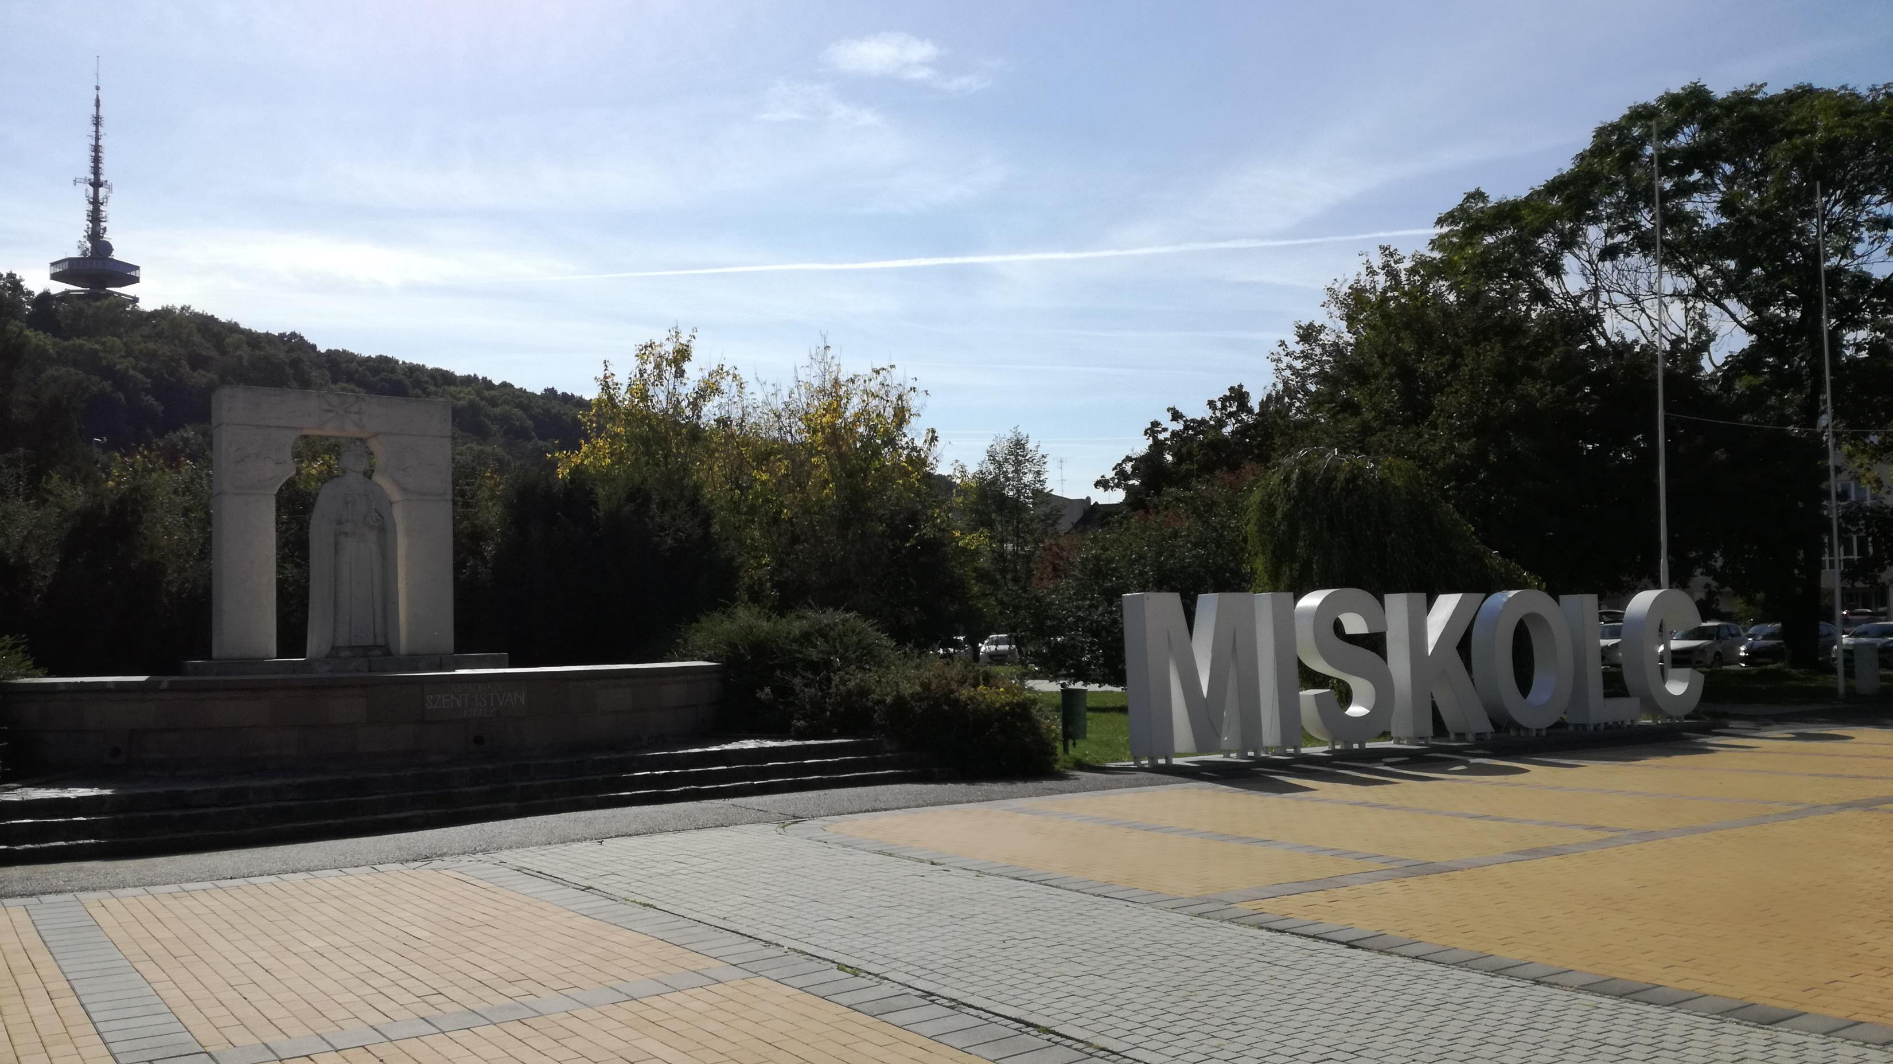

Slide 3
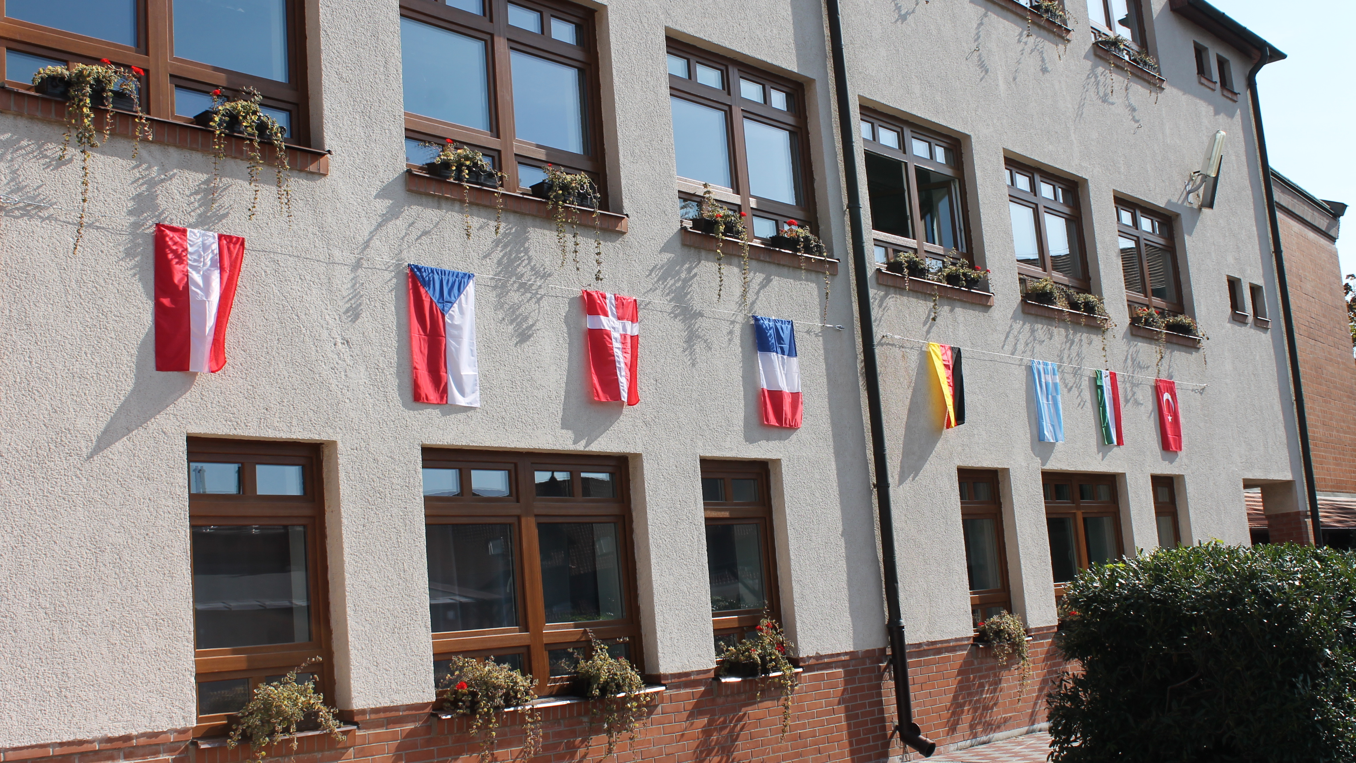

Slide 4
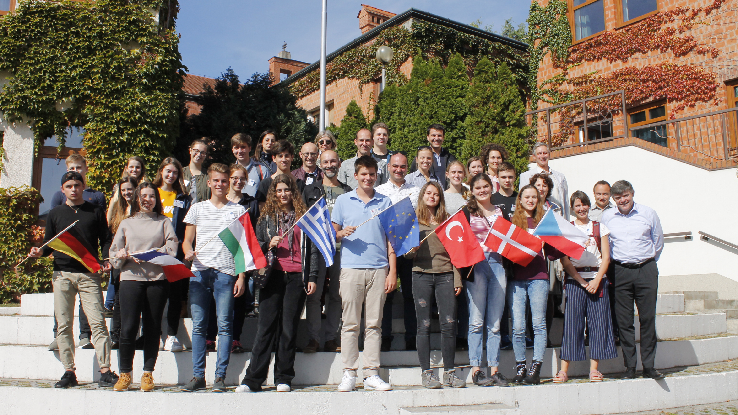

Slide 5
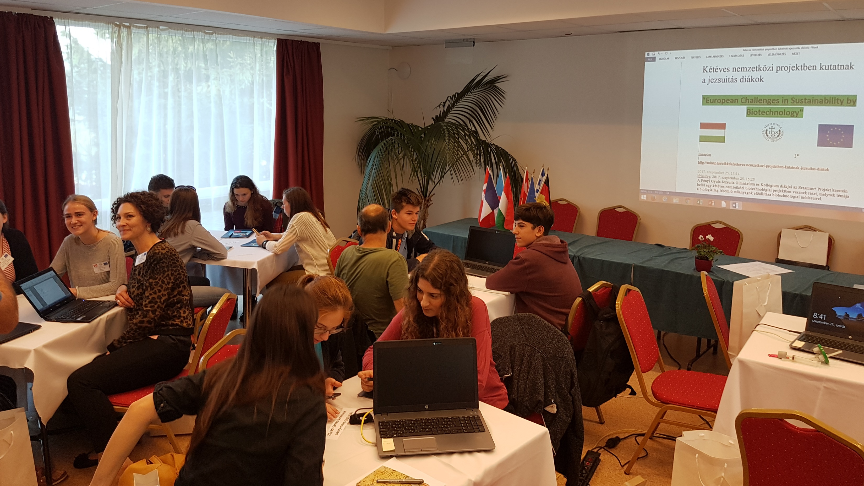

Slide 6
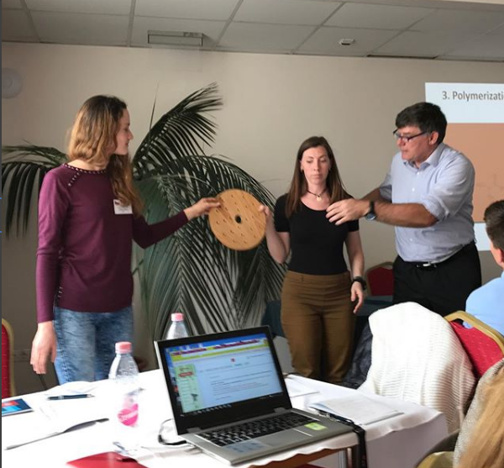

Slide 7
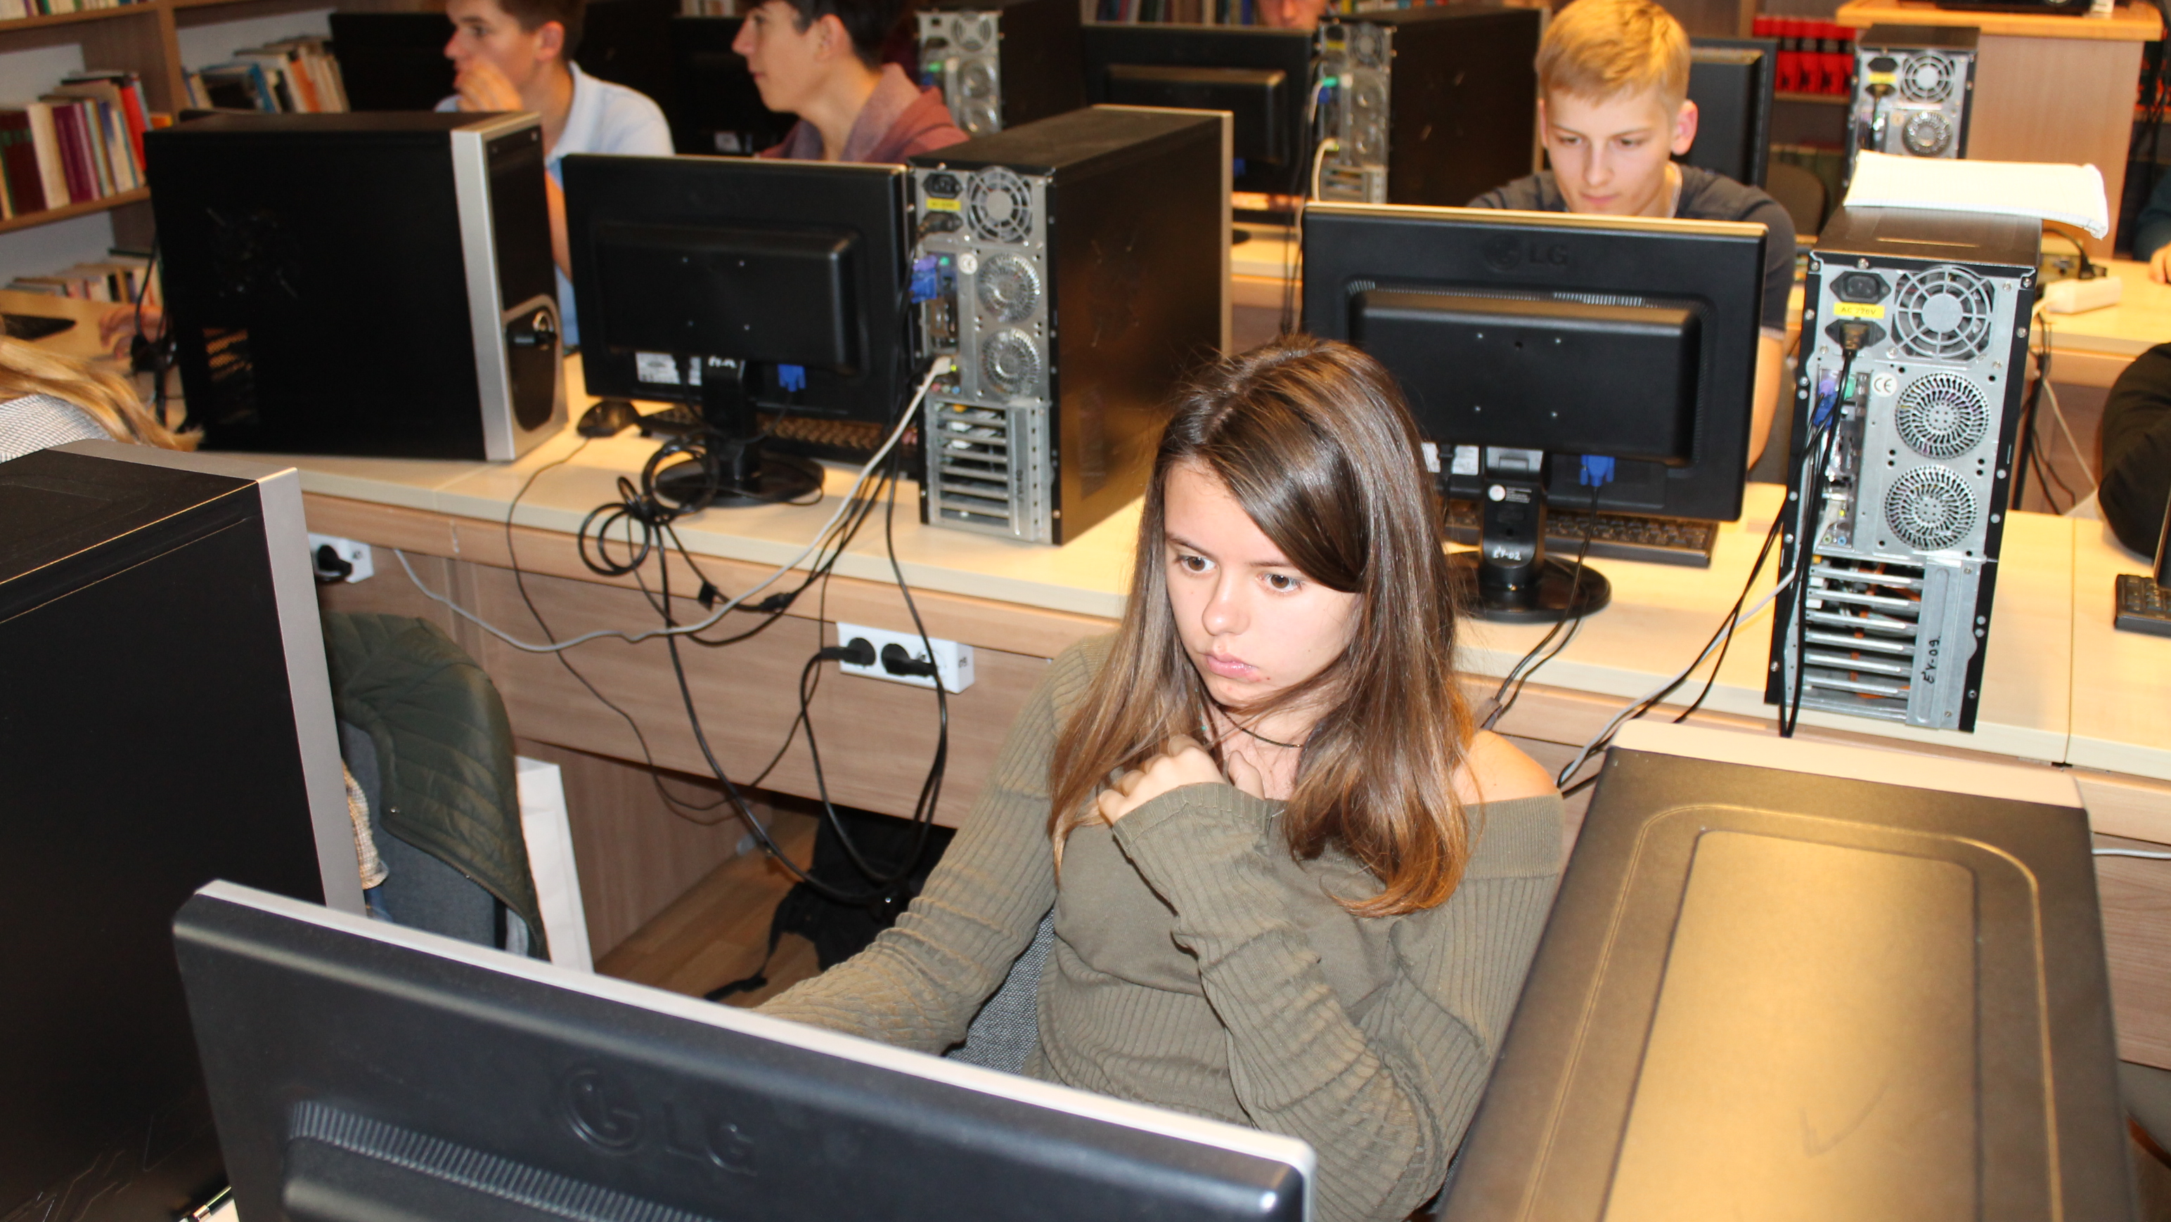

Slide 8
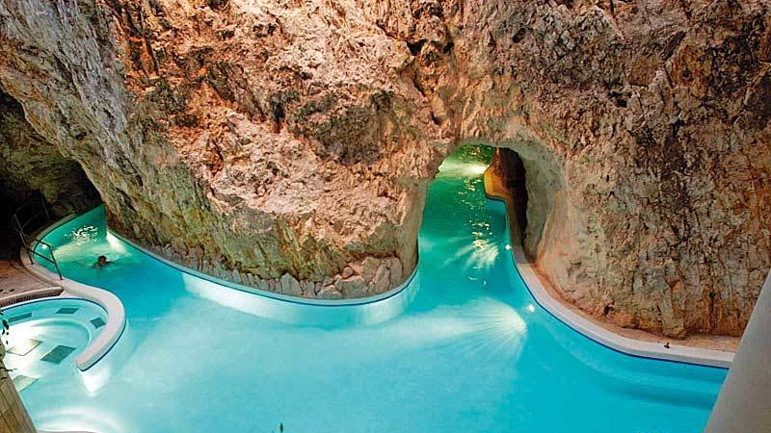

Slide 9
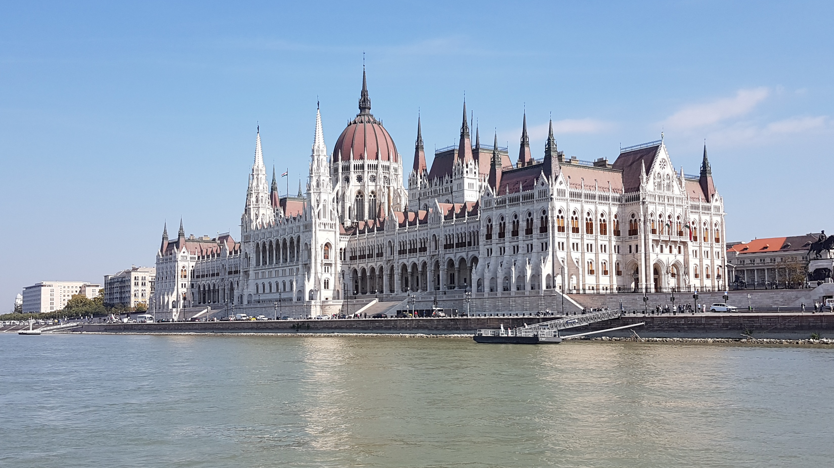

Slide 10
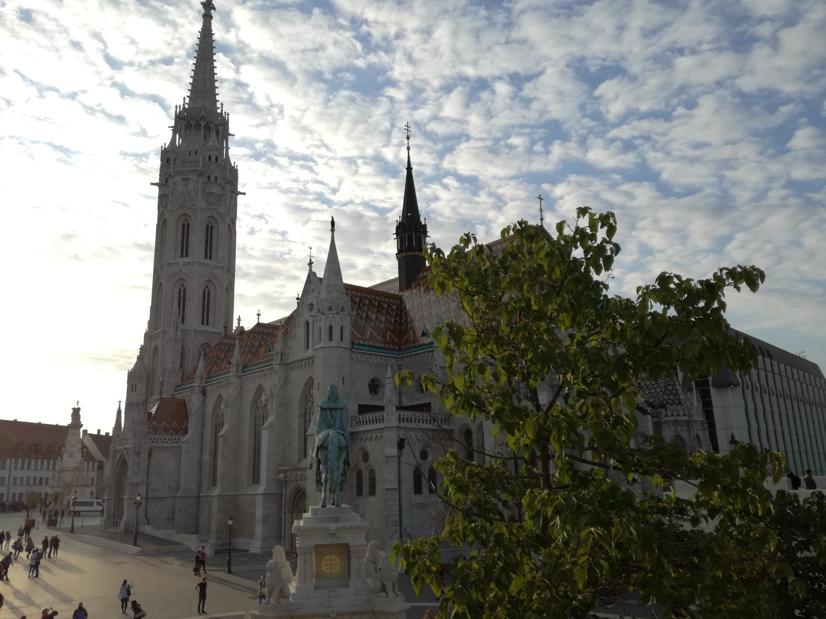

Slide 11
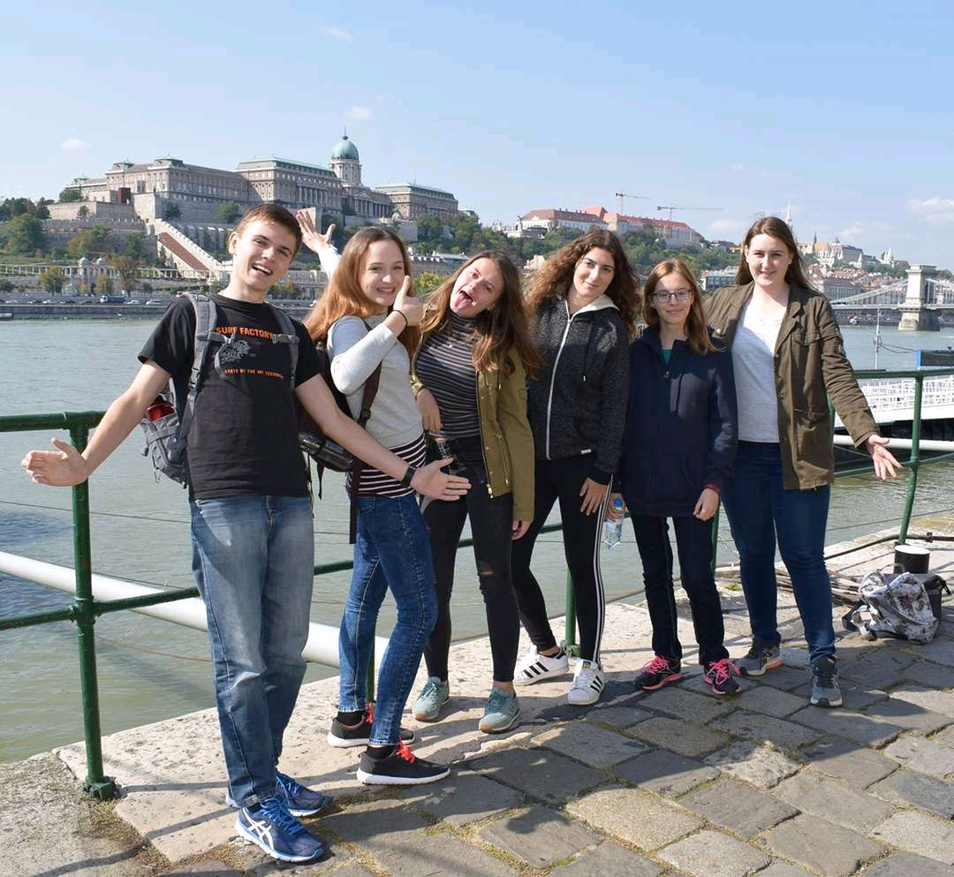

Slide 12
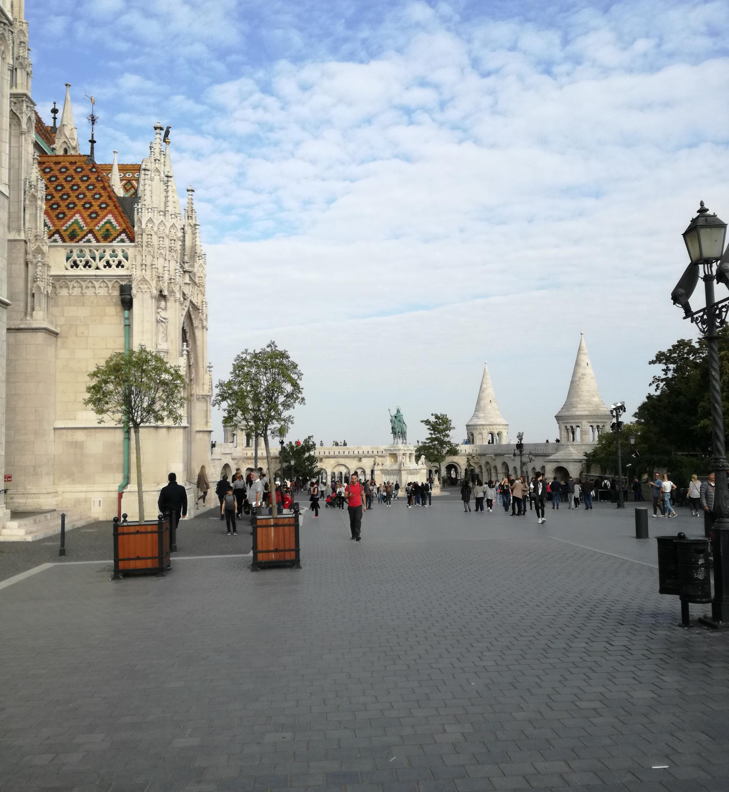
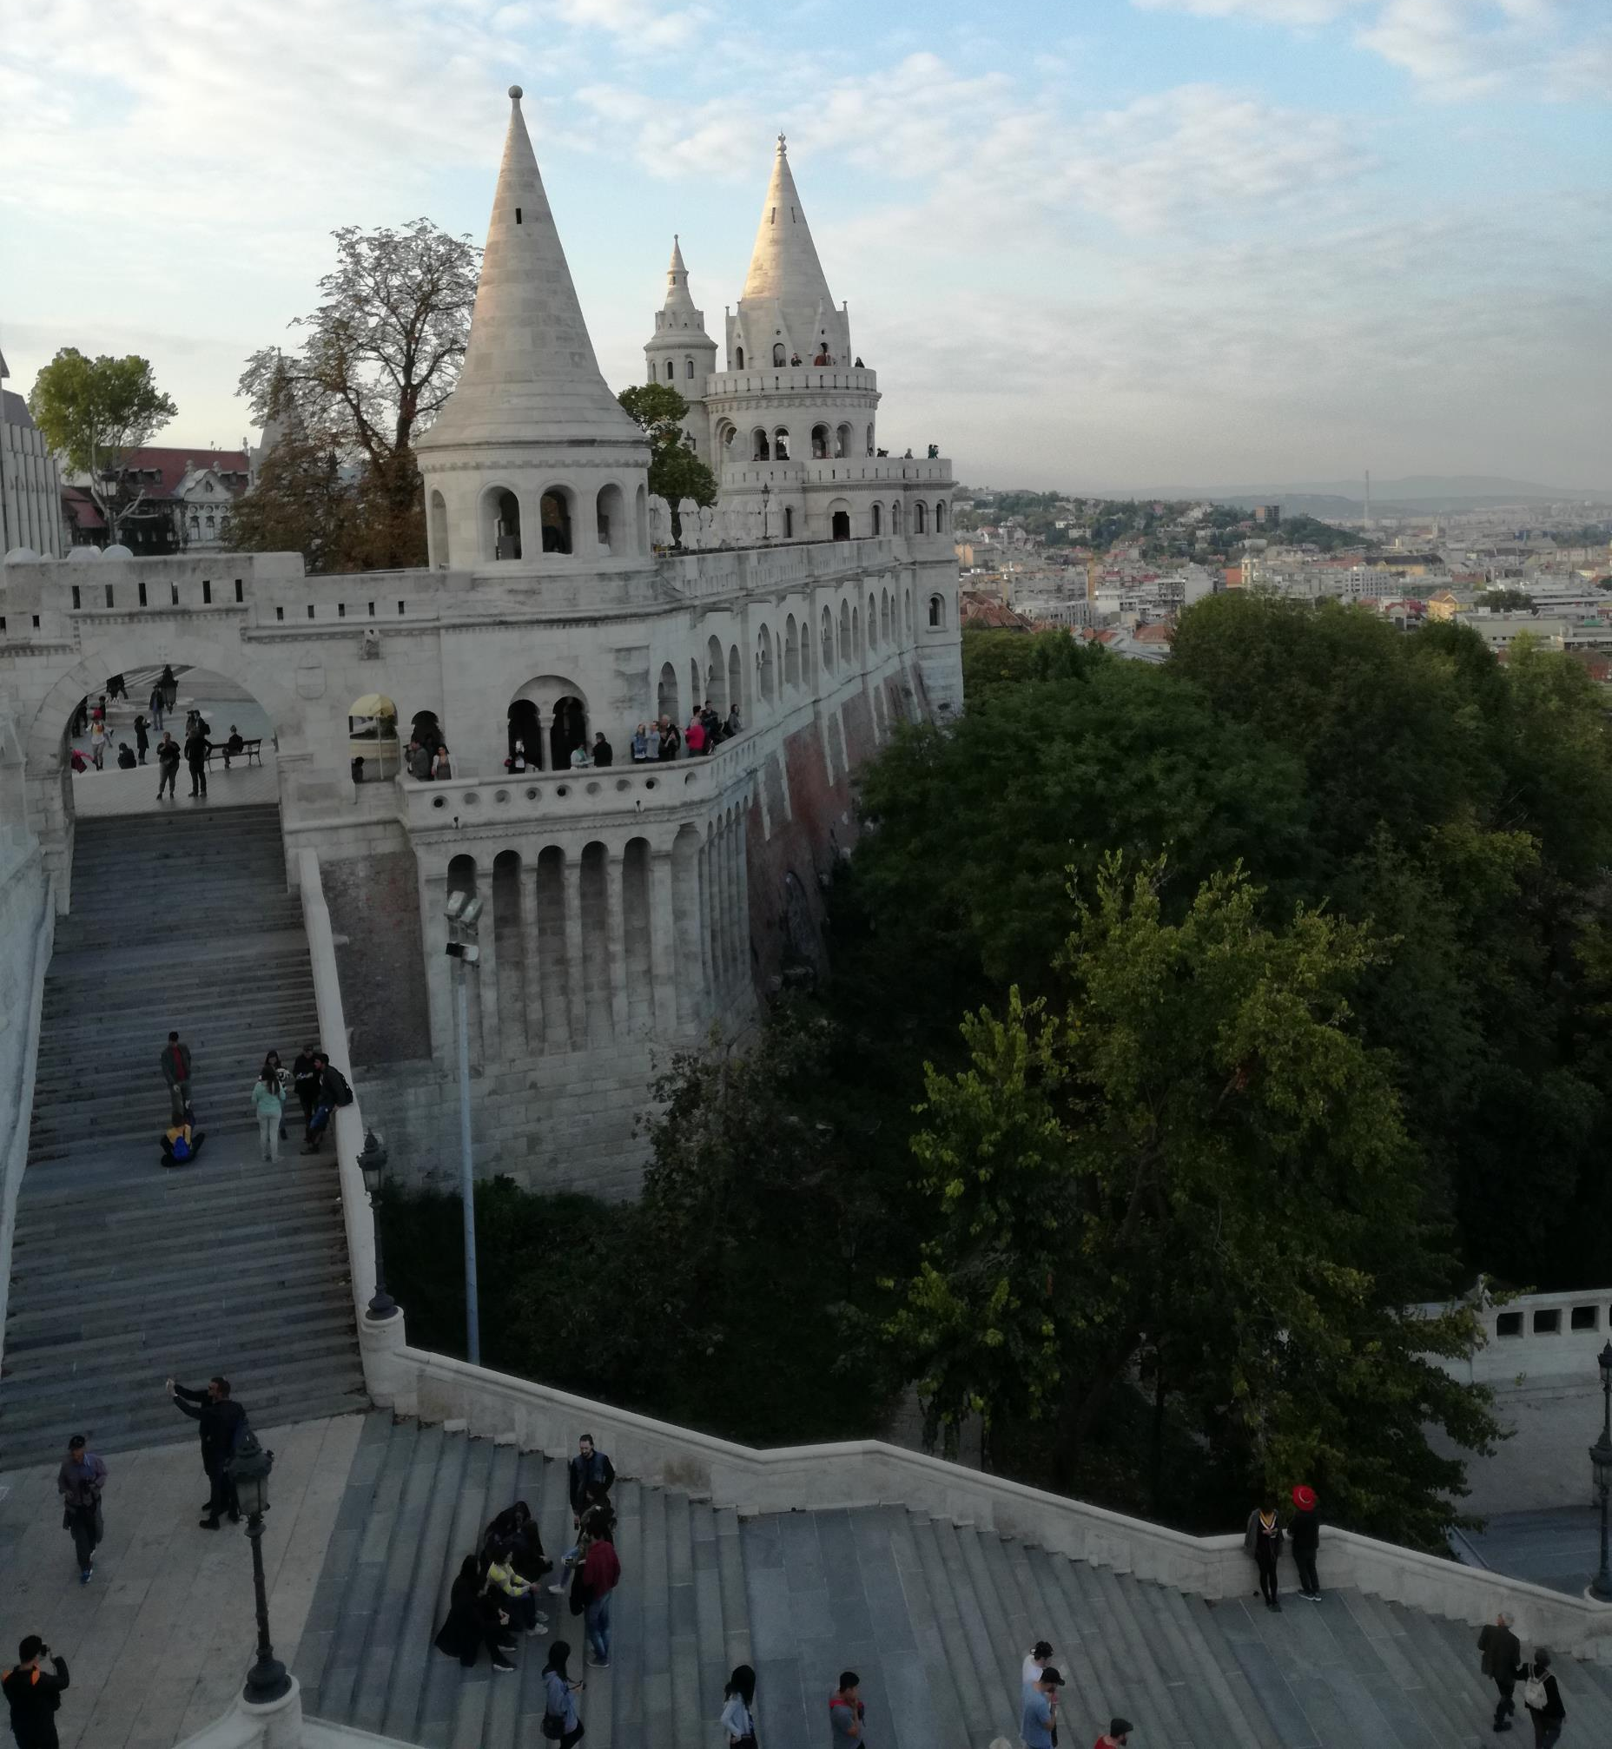

Slide 13
Sociální sítě
Instagram: https://www.instagram.com/biotechproject/
Facebook: https://www.facebook.com/groups/1908984959355253
Youtube: https://www.youtube.com/channel/UCYg2MDTENYyHDhkTkSR6o2w
Website: http://www.sustainabilitybybiotechnology.com/

