Slide 1


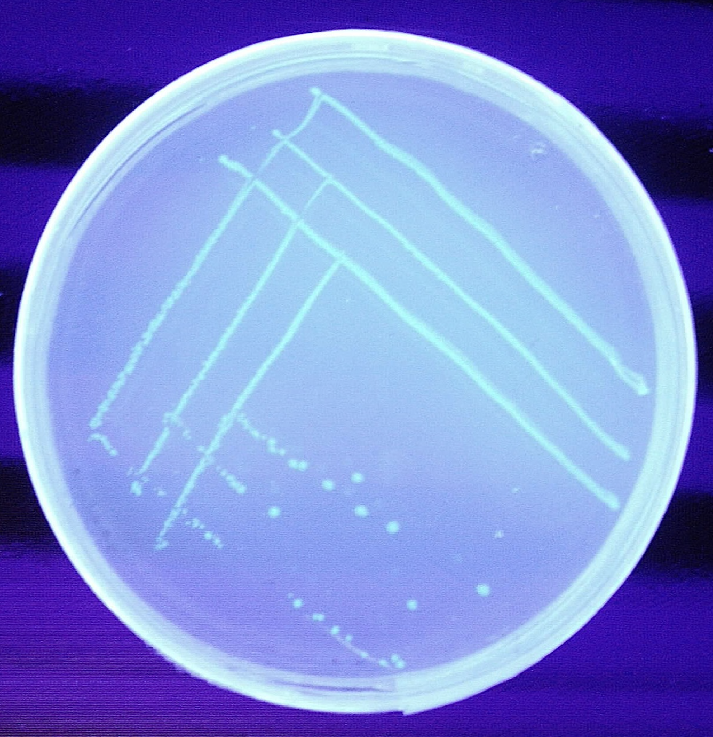
Workshop Downstream Processing
Meeting in Evreux
Isolation, Purification and Evaluation of Purification by PAGE of Green Fluorescing Protein (GFP) produced by E. coli
Introduction and Overview

Slide 2
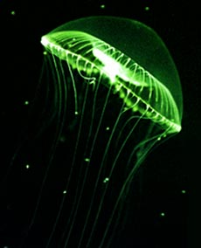
Gfp-gene and GF-Protein
Gfp-gene is coding for the Green Fluorescing Protein (GFP)
Gfp-gene is existing in nature
in the genome of the jelly fish
Aequorea victoria
Notes:
Notizen.

Slide 3
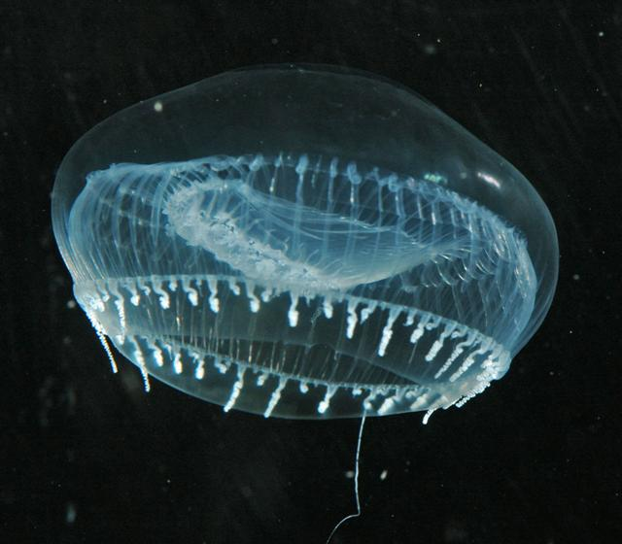
Use of GFP in Nature
In the deep see the glowing by GFP is to attract sexual partners.
Furthermore a sudden glowing is
a defence mechanism against enemies
for the jelly fish.

Slide 4
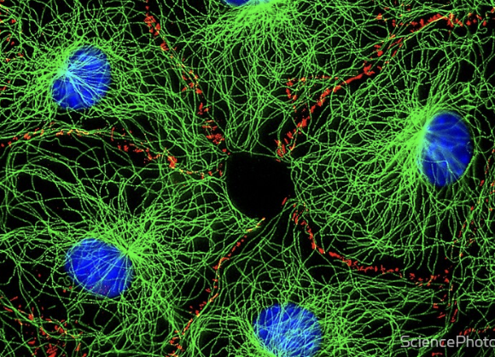
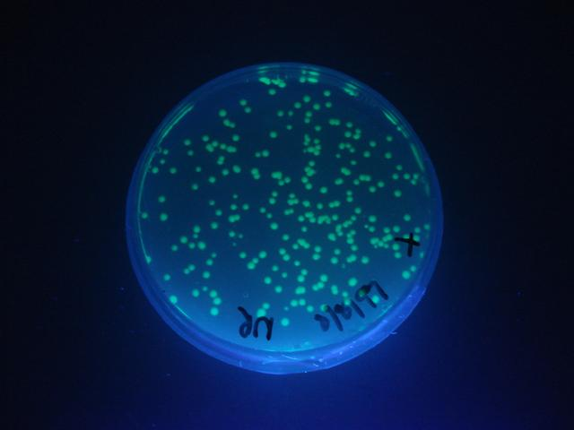
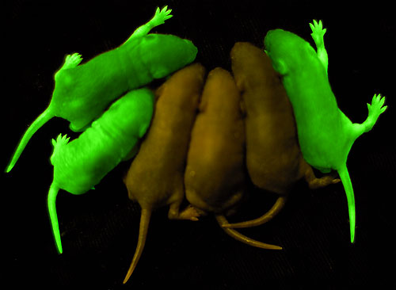
Use of GFP in Science
In Molecular Biology the gene coding for GFP is used as a reporter gene.
Inside successful genetic modified cells or complex organisms GFP screening in UV radiation reports the gfp-expression.

Slide 5
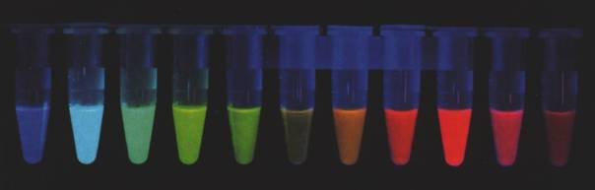
Other (artificial) Fluorescing Proteins
Nobel Price 2008: Osamu Shimomura 1961 (exploration of GFP in nature),
Martin Chalfie (reporter gene) and Roger Tsien (different colours)

Slide 6
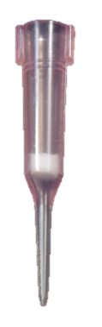
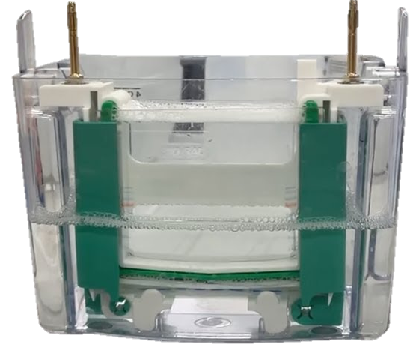
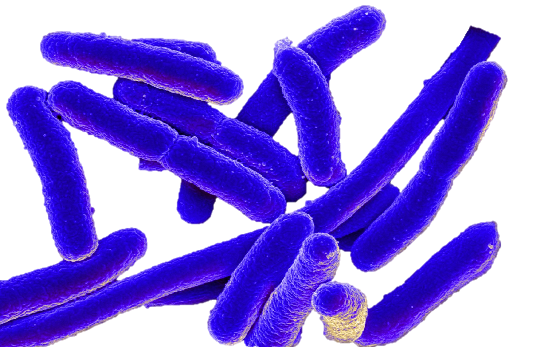
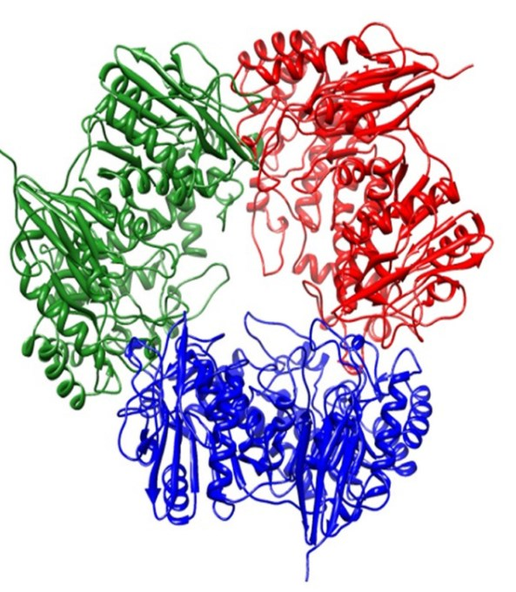
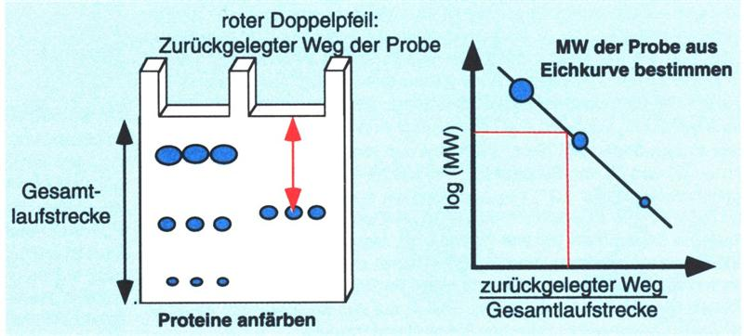
Overview of the Experiment
Goal:
Expression of gfp-Gene, Cell Lysis, Purification by Chromatography,
Purification Test by SDS-PAGE and Molare Mass Estimation of GFP
3. Purification
E. coli
expressis GFP
4. SDS-PAGE
5. Molare Mass
Estimation
2. Cell Lysis

Slide 7
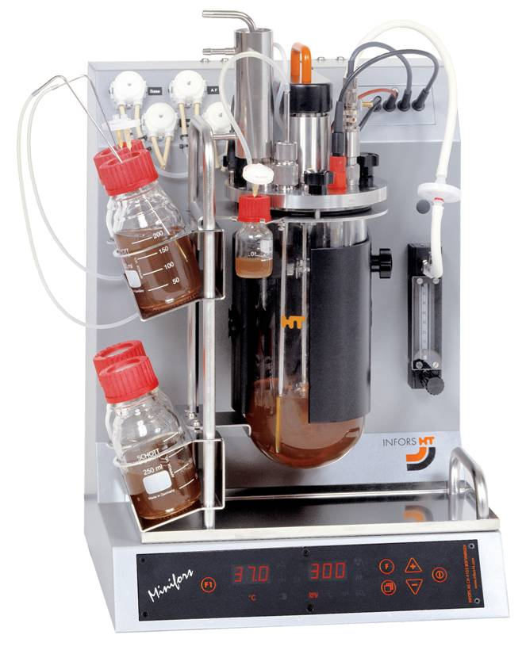
1. Step: Goal is the Over Expression of GFP in E. coli
Stem E. coli K12 HB 101
Genetically modified with a plasmid containing
- the resistance gene amp^{r} for
selecting the bacteria
- the arabinose operon includes
the gfp gene regulated by the
arabinose promoter

Slide 8
1. Step: Goal is the Over Expression of GFP in E. coli
If OD > 2,5
Add arabinose to the nutrient
Stem E. coli K12 HB 101 starts expressing GFP
GFP gets visible in UV radiation already after
adding arabinose for
25 minutes.

Slide 9
Gfp-Gene is included into the Arabinose Operon of
E. coli
Only arabinose can induce as substrate inductor the expression of the arabinose operon.
If arabinose is available in the nutrient the arabinose operon is expressed and so also the included gfp gene is expressed coding for GFP.
→ arabinose operon can be expressed,
→ and GFP is produced.

Slide 10
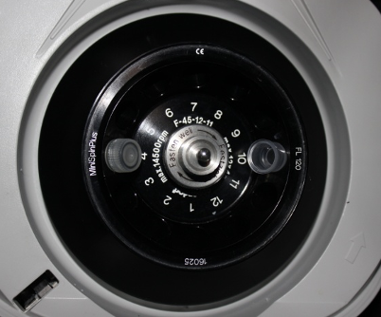
Separation of E. coli Cells
40 mL aliquots of the fermentation media are centrifuged for 10 minutes at 5000 rpm.

Slide 11
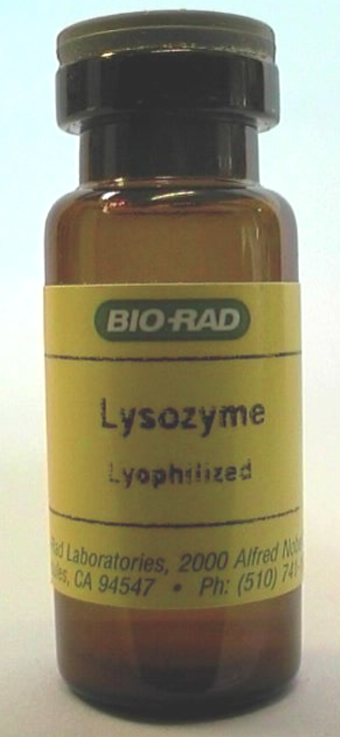
2. Step: Cell Lysis
Gram negative E. coli cell walls are lysed by the enzyme lysozyme.
Bacteria are resuspended by 750 𝜇L PM-buffer.
350 𝜇L lysozyme solution is added and mixed by snipping.

Slide 12
2. Step: Cell Lysis
The mixture is incubated for 20 minutes at 37 °C.
To increase cell lysis rate the mixture is frozen till purification at -18 °C.

Slide 13
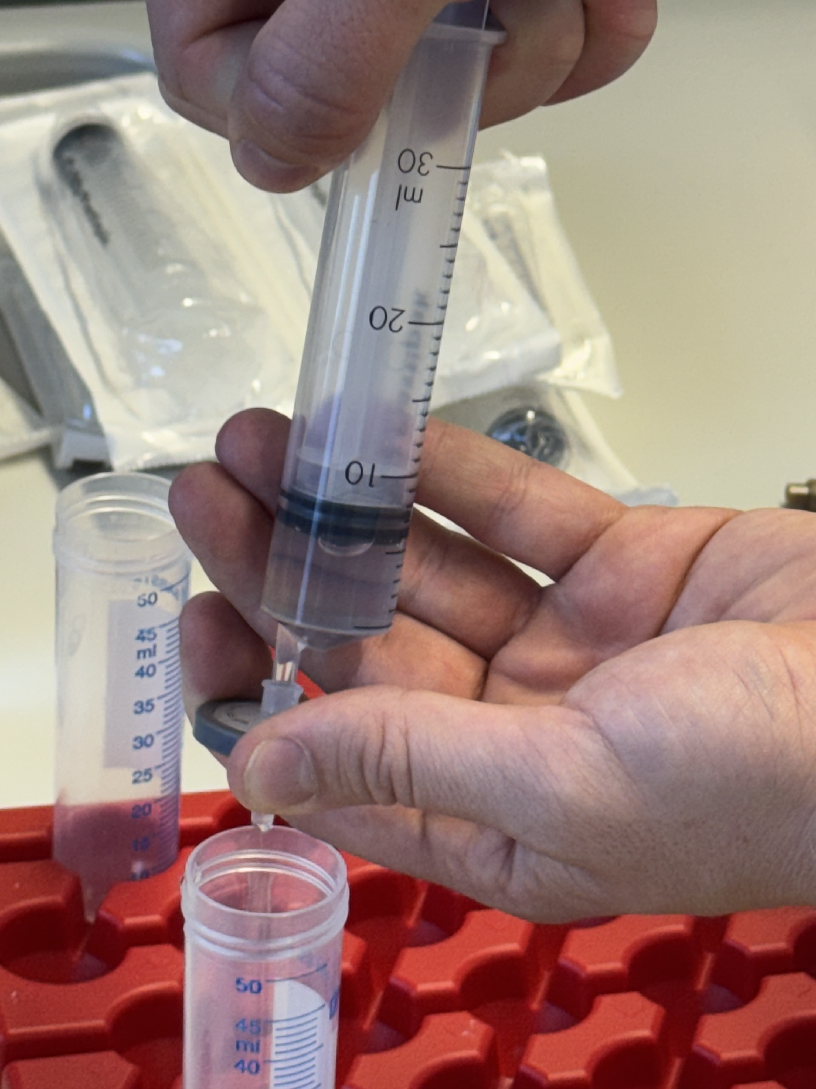
2.1 Production of a
Particle Free Lysate
By centrifugation and filtration
cell debries are taken out of the
lysate.
By UV radiation the GFP is visible by green fluorescence.

Slide 14
Step 3: Purification by Chromatography
Chromatography is a method to separate one substance out of a mixture with many different substances,
e.g. a protein of interest out of a mixture of many proteins, DNA etc. existing in a cell.
To reach the separation goal in chromatography is used a stationary and a mobile phase which have different abilities e.g.
- if the stationary phase is polar → then the mobile phase is relative to the stationary phase non polar
- if the stationary phase is non polar → then the mobile phase is relative to the stationary phase polar

Slide 15
Step 3: Purification of the Protein of Interest by
Column-Chromatography
If the molecule of interest is non polar
  → it binds to a non polar stationary phase by hydrophobic
  interactions called Van der Waals forces
  → polar substances can`t bind to the stationary phase
  → time of stay inside the column of polar and non polar
  substances is different,
  called adsorption chromatography.

Slide 16
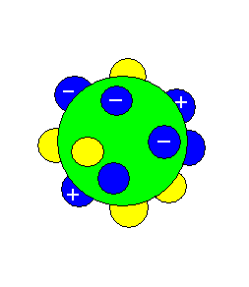
Hydrophobic Interaction Chromatography
to separate GFP out of a Cell Lysate
Non polar aminoacid residues
Unpolare AS-Reste
Polar aminoacid residues
Polare AS-Reste
GF Protein

Slide 17
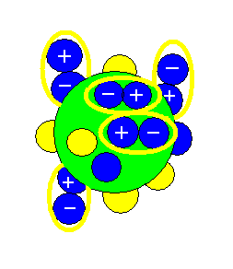
polares- unpolares Protein
polar
non polar Protein
+ (NH₄)₂SO₄
- (NH₄)₂SO₄
Polar protein
can`t interact with non polar stationary Phase.
Non polar protein binds by van-der-Waal-Forces to hydrophobic, non polar stationary phase.

Slide 18
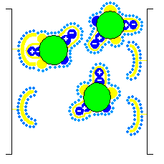
Adsorption
Polyacrylate
as column
matrix
Methyl-Group
as non polar ligand of the stationary phase
H₂O
Mobile phase

Slide 19
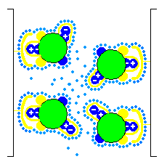
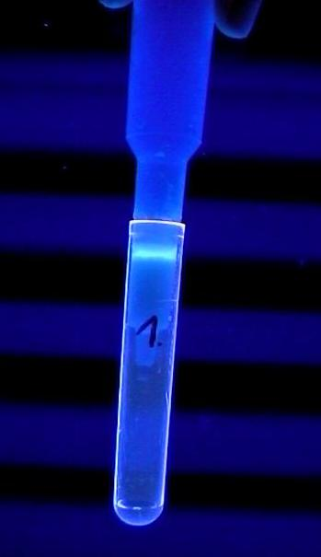
Adsorption
High salt concentrations
Non polar GFP is attached
by Van-der-Waals-forces to the methyl groups of stationary phase

Slide 20
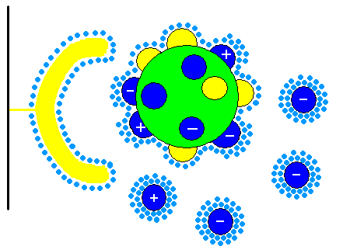
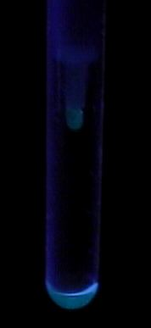
GFP at low salt concentrations gets polar
Elution

Slide 21
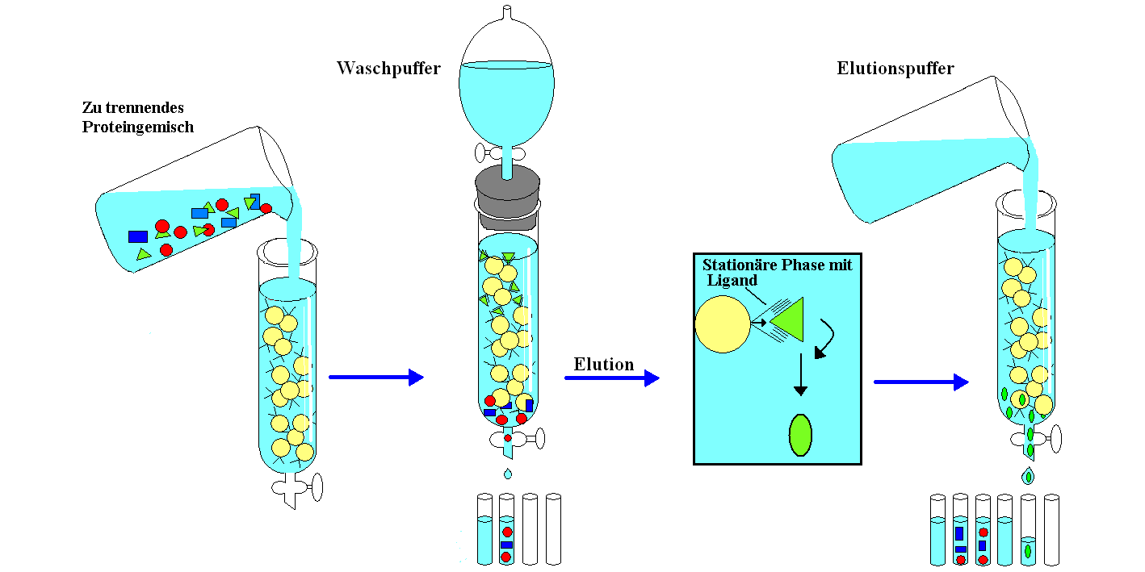
Principe of Column Chromatography
Loading step with the mixture to separate
Washing step
Elution step
Washing fractions
Collected product fractions

Slide 22
3. Purification the Protein of Interest by
Chromatography
Column Chromatography procedure is devided in the following steps:
  Equilibration of the stationary Phase inside the column
  Loading the stationary phase with the sample (mixture of substances) = mobile phase → compounds in the mixture are coming in a kind of interaction with the stationary phase (e.g. van-der-Waals forces, Dipol-Dipol-Forces,
  H-bridges, Size exclusion etc.
  Washing the stationary phase: Fixed compounds stay in the column, not fixed compounds are flowing through the column
  Elution of the substance of interest by changing salt concentration or pH
  Reequilibration of the column

Slide 23
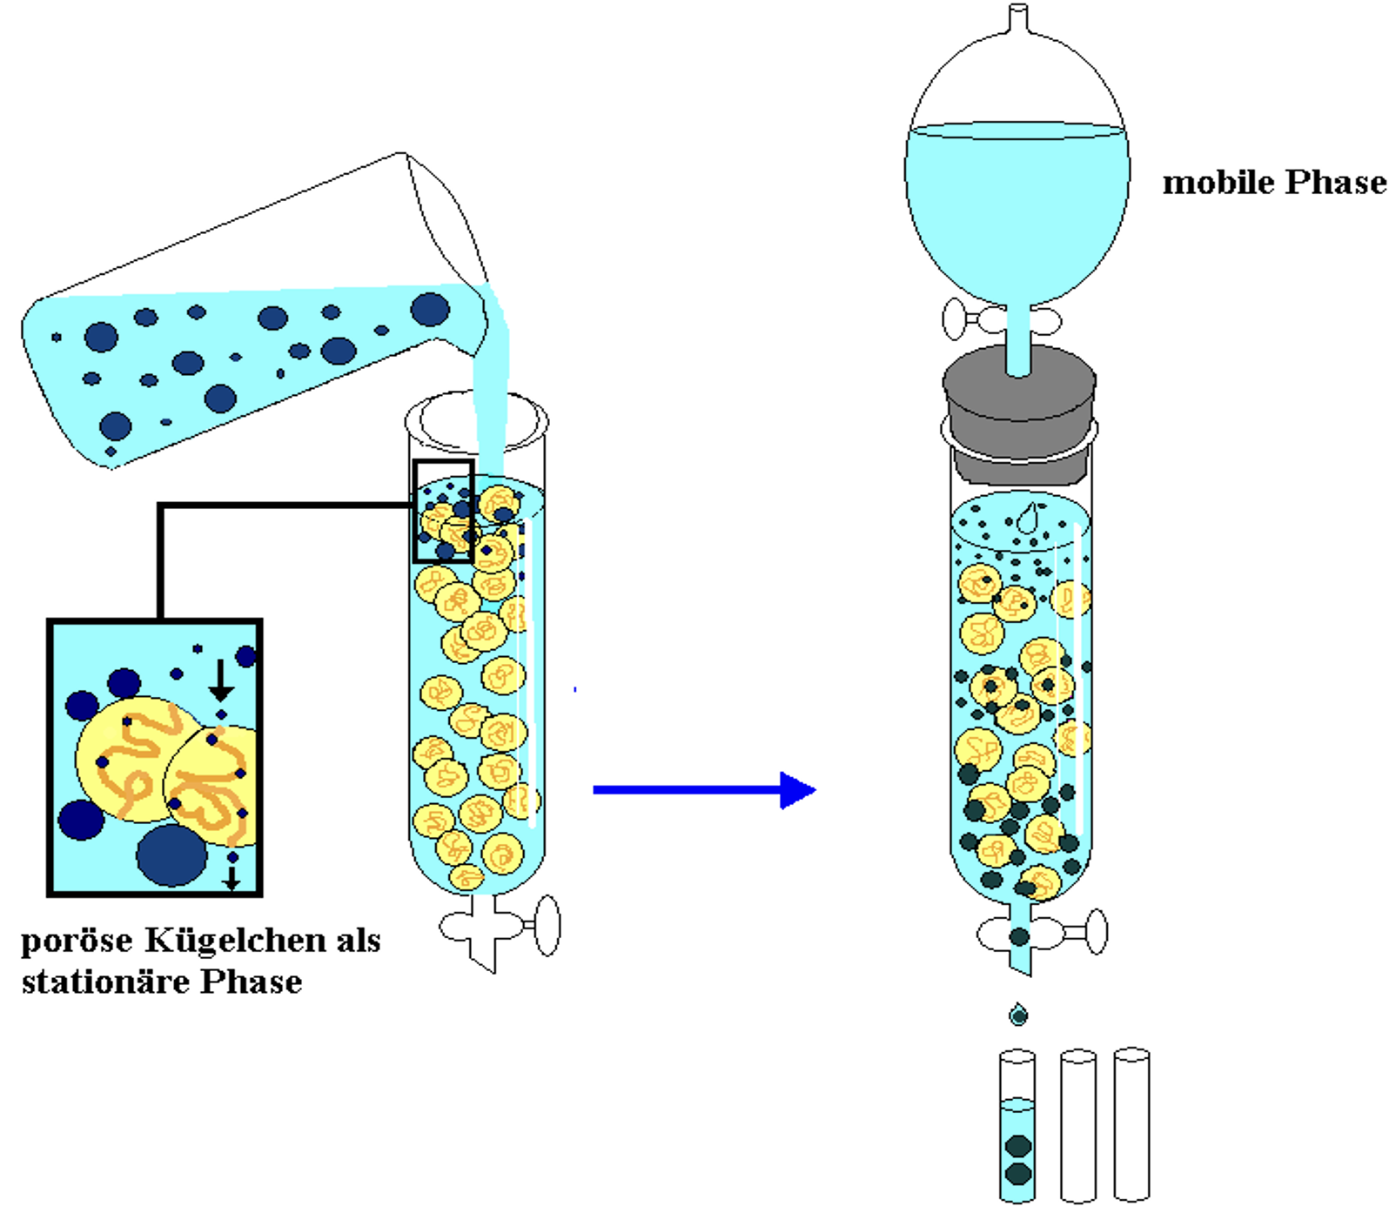
Gel Filtration
Stationary Phase:
Beads with pores
Mobile Phase:
Liqiud
Seperation Principe:
Small Molecules are going through the pores of the stationary Phase
Big molecules passes the beads

Slide 24
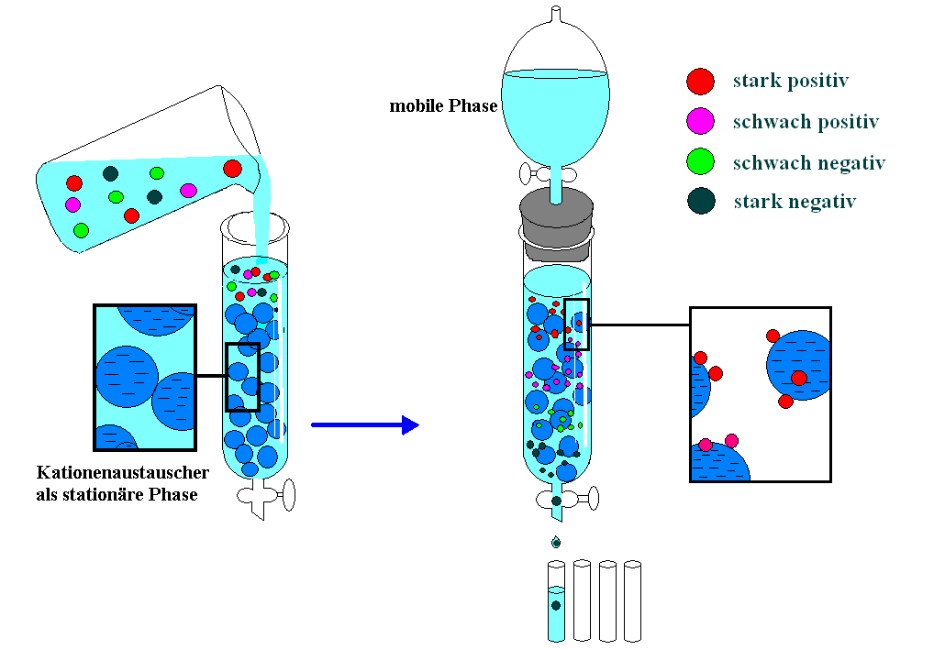
Ions Exchange Chromatography

Slide 25
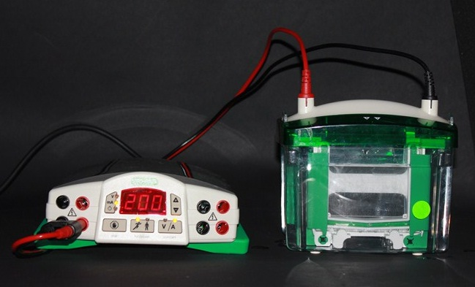
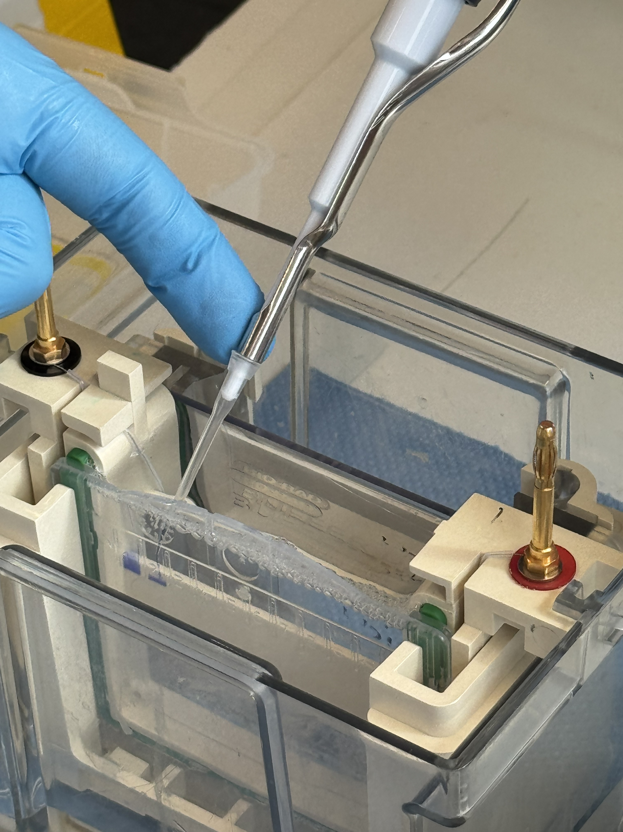
Purification Test of GFP
By SDS-PAGE
  Samples before and after Chromatography

Slide 26
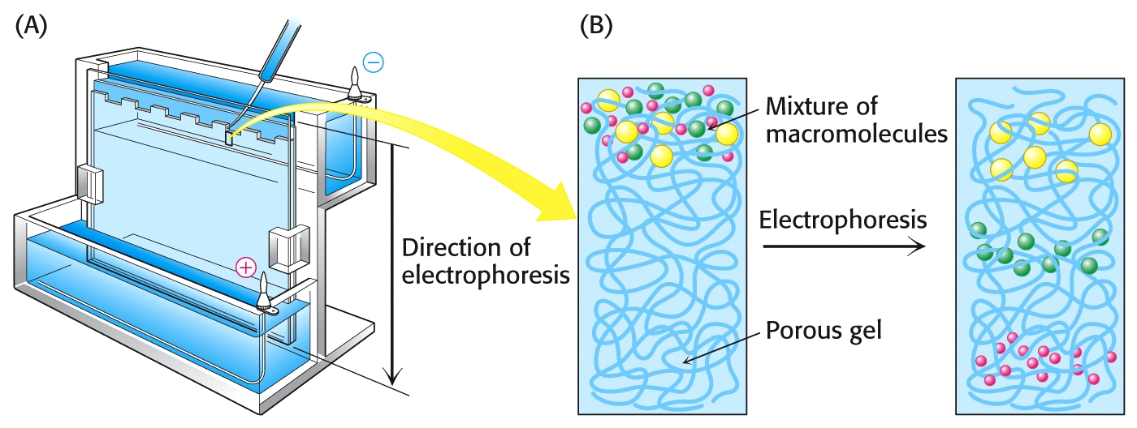
Polyacrylamide Gel Electrophoresis (PAGE)
Notes:
Notizen.

Slide 27
PAGE Animation

Slide 28
E. Coli Lysat
Durch-fluss HIC
Durch-fluss 1 GF
Durch-fluss 2 GF
Längen-standard

Slide 29
Molecular Mass Estimation by Calibration Line
Migration Rate of Substance of Interest in cm
Calibration Line
Migration
Rate of
Marker
Proteins
Migration Rate in cm

