Slide 1
Edinburgh
9. – 20. 7. 2018
Active Methodology Course

Slide 2
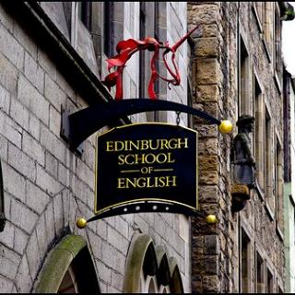
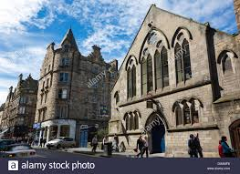

Slide 3
Our group
We were a small group of 6 people:
2 from the Czech Republic, 2 from Poland, 1 from Germany, 1 from Italy
a very cooperative surroundings, different backgrounds, a great teacher, interesting topics
we are still in touch through WhatsApp

Slide 4
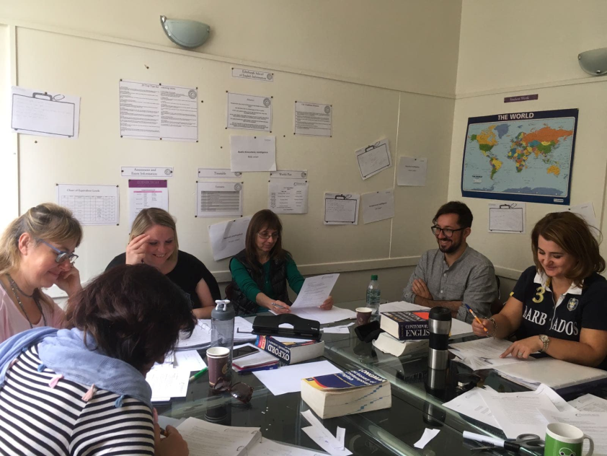
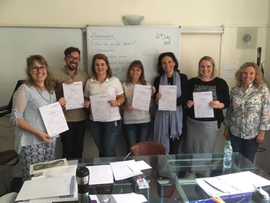
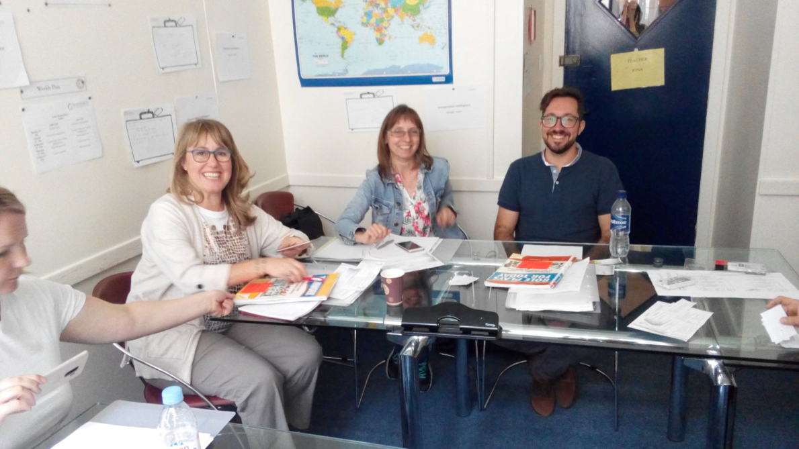
Some photos from the class…

Slide 5
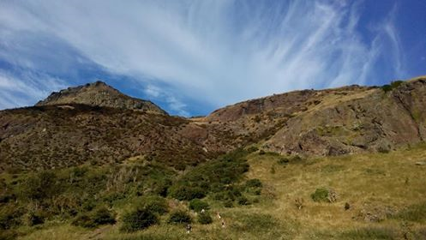
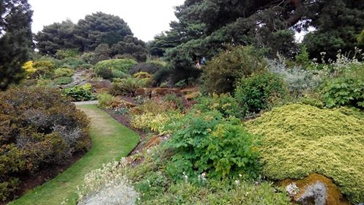
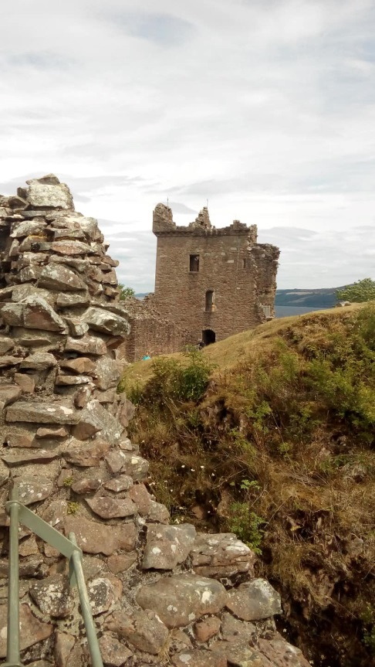
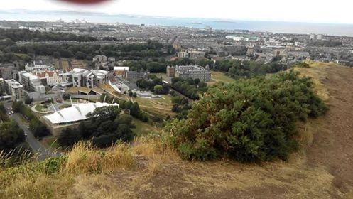
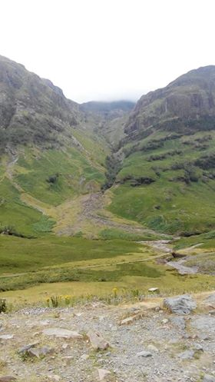
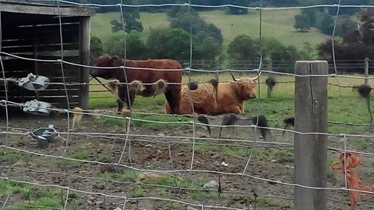
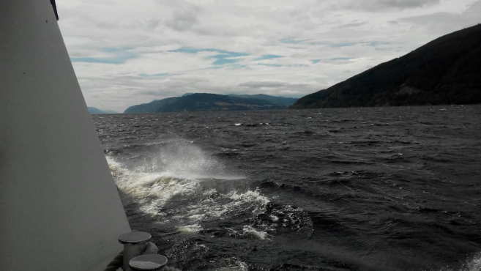
…and outside
Edinburgh from Arthur's Seat

Slide 6
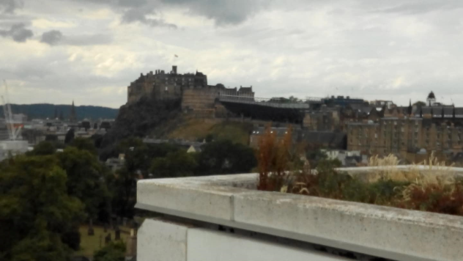
…and outside
Edinburgh Castle

Slide 7
…and outside
The Royal Botanical Gardens

Slide 8
…and outside
Arthur's Seat

Slide 9
…and outside
The Highlands - Glencoe

Slide 10
…and outside
Loch Ness - castle and lake

Slide 11
…and outside
Highland cows

Slide 12
The Course Content
Classroom management - potential problems, frequent mistakes
Effective classroom management
Multiple Intelligences – different attitudes, types of activities suitable for each of them, planning the lessons with respect to the pupils needs
Some practical tips and activities

Slide 13
Multiple Intelligences

Slide 14
The Course Content
Teaching grammar – attitudes, presenting grammar
Errors and error correction – to correct or not to correct
Concept check questions – use in teaching grammar, lexis, comprehension…
Teaching writing – some ideas for guided writing, motivation, Haiku

Slide 15
The Course Content
Teaching reading – strategies, types of activities – again with respect to multiple intelligences, effective reading
Teaching vocabulary – presenting, knowing the word
Teaching speaking – how to make speaking activity motivating
Teaching pronunciation – activities

Slide 16
The Course Content
Projects – some practical examples
The Great Egg Drop
A new smartphone app
The Dragons‘ Den
The Great Museum Heist

Slide 17
Some materials for your use
Teaching materials.pdf
That‘s all Folks….

